Slide 1
FEDERAL MINISTRY OF AVIATION ROADMAP/PUBLIC PRIVATE PARTNERSHIP (PPP) PROJECTS

Slide 2
PREAMBLE
SITUATION ANALYSIS
On assumption of duty in November, 2015 an aviation sector diagnostic review was undertaken and a road map was developed, which was presented to stakeholders during the first meeting on May 16, 2016. The diagnostic review identified the following challenges:
Inadequate Safety, Security and Surveillance Equipment.
Decaying/ageing infrastructure and obsolete equipment.
Large number of unemployed trained professional Nigerian Aviators.
High debt profile of domestic airlines operators.
Ageing and over-bloated work force in the Aviation Agencies.
Difficulties in accessing foreign exchange by operators.

Slide 3
PREAMBLE…/2
SITUATION ANALYSIS CONT’D
Poor and intolerable condition of airport facilities and equipment (long waiting and check-in times, time–consuming security screening and baggage pick ups).
High cost of funds and shrinking capital market.
Rising price and scarcity of Jet A 1 (Aviation Fuel).
Import duties on Aircraft engine and spares.
Budgetary Constraints.

Slide 4
PREAMBLE…/3
COMPONENTS OF AVIATION ROAD MAP
The Aviation Sector Road Map which is aimed at creating enabling environment for the industry to thrive comprises the following closely related components:
Concession of Airports
Establishment of a National Carrier
Development of Agro-Allied /Cargo Terminals
Establishment of Maintenance, Repairs and Overhaul (MRO) Centre
Establishment of an Aviation Leasing Company (ALC)
Development of Aerotropolis (Airport Cities)

Slide 5
PREAMBLE…/4
COMPONENTS OF AVIATION ROAD MAP CONT’D
Establishment of an Aerospace University.
Improvement in Aviation Safety and Security through upgrade and
Modernization of Aviation Infrastructure and facilities.
Upgrade of NCAT into an ICAO Regional Training Centre of Excellence.
Introduction of Policies on Remotely Piloted Aircraft.
Adherence to Employment Policies on the Enforcement of
Expatriate Quota.

Slide 6
PREAMBLE…/5
COMPONENTS OF AVIATION ROAD MAP CONT’D
Upgrade of AIB to a Multi -modal Accident Investigation Agency – National Transport Accident Investigation Board (NTAIB).
Establishment of a Search and Rescue System

Slide 7
STATUS OF THE ROAD MAP:

Slide 8
STATUS OF THE ROAD MAP/PPP PROJECTS
CONCESSION OF AIRPORTS
The concession of the four (4) major international airports will help fast-track their upgrade, enhance their operational efficiency, profitability and reposition them to operate competitively.
The project is being structured as a Terminal Concession under a Public Private Partnership (PPP) arrangement between the Government and the Private Sector where the private investor will be required to upgrade, manage and operate the airport terminals over the concession period.
Airports to be Concessioned are as follows:
Murtala Muhammed International Airport (MMIA) Lagos: International and Cargo Terminals;
Nnamdi Azikiwe International Airport (NAIA), Abuja: International, Domestic and Cargo Terminals
Port Harcourt International Airport (PHIA), Port Harcourt: International, Domestic and Cargo Terminals.
Mallam Aminu Kano International Airport (MAKIA), Kano. International, Domestic and Cargo Terminals
STATUS: Project Development Phase completed with the development of the Outline Business Case (OBC) and subsequent issuance of compliance certificate by the Infrastructure Concession Regulatory Commission (ICRC).
NEXT STEP: Placement of Request for Qualification (RFQ) in local and International media

Slide 9
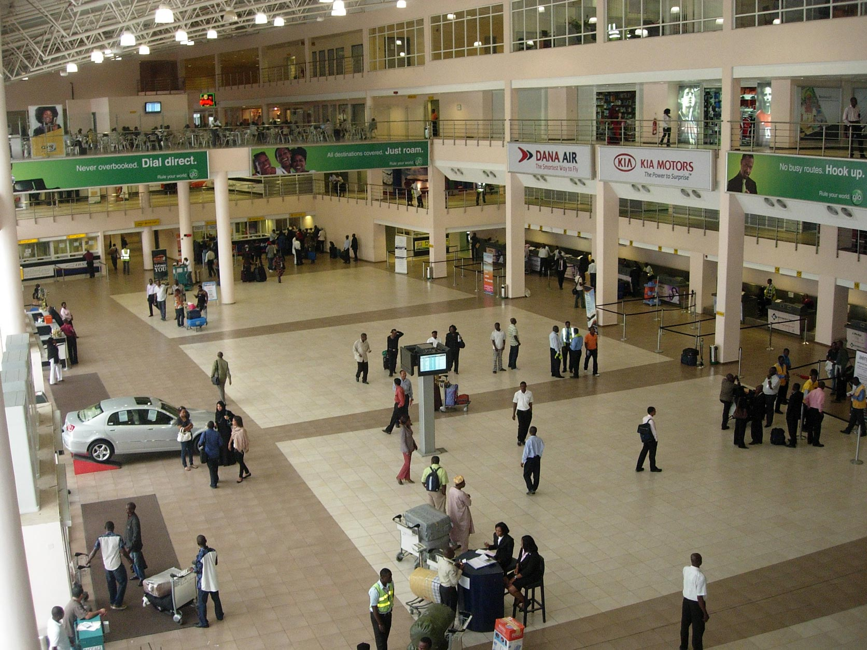
SUB – NATIONAL LEVELS/COLLABORATION
Airport Concession
While the process of concession is on-going for the four (4) major International Airports, the State Governments can be part of a consortium to bid for these airports as well as other domestic airports.

Slide 10
Establishment of a National Carrier
The establishment of a National Carrier will enable Nigeria gain optimal benefits from BASA Agreements, take full advantage of the Single African Air Transport Market (SAATM), introduce competition, leading to competitive fares and better services as well as generate employment.
The National Carrier project will be private sector driven, with the government holding not more than 5% of the shares. The private sector consortium may comprise reputable International Airlines(such as Qantas), Leasing Companies, Aircraft manufacturers (OEMs), Financial and Institutional Investors.
The Government is providing the required support by creating the enabling environment in terms of sustainable policies, allocation of BASA routes, provision of financial guarantees and ensuring fiscal incentives to sustain the success of the airline.
STATUS: Project Development Phase completed with the development of the Outline Business Case (OBC) and subsequent issuance of compliance certificate by the Infrastructure Concession Regulatory Commission (ICRC).
NEXT STEP: Placement of Request for Qualification (RFQ) in local and International media

Slide 11
SUB – NATIONAL LEVELS/COLLABORATION
National Carrier
The Next set of steps will involve the commencement of Procurement Phase by placing advert for Request for Qualification in the National Dailies and the Economist Magazine.
State Governments and other private businesses are invited to participate in this process.
$250Million approximately is to be raised to start up the airline by private investors

Slide 12
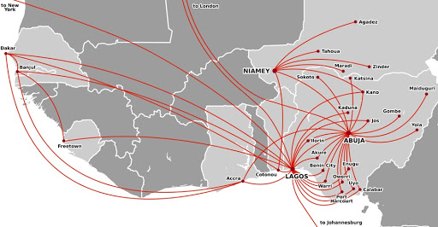
SUB – NATIONAL LEVELS/COLLABORATION
Flight Route Development
State Governments are invited to collaborate with airlines by paying for seats to encourage local and regional operations from the various states.
State Governments are also encouraged to set up Private Airlines to take advantage of prospective routes both locally and regionally e.g Abom Air, Cally Air, United Air etc

Slide 13
Establishment of An Aviation Leasing Company
The Aviation Leasing Company (ALC) will provide leasing opportunities for Nigerian and African airlines in order to boost fleet size, alleviate the problem of aircraft leasing and high insurance premium charges.
The ALC has been structured as a Joint Venture between the Government and Private sector, and its business objectives will be to initially lease aircraft from international lessors and subsequently sub-lease to African airlines, and in the future acquire, own and lease its own aircraft.
The Government is considering providing financial guarantees and ensuring fiscal incentives to facilitate the success of the ALC.
STATUS: Advanced stage in the Procurement Phase. A preferred partner has been selected, negotiations to commence soon
NEXT STEP: Commencement of negotiations with preferred partner and finalisation of Full Business Case (FBC)

Slide 14
Establishment of a Maintenance, Repair & Overhaul (MRO) Centre
The proposed independent MRO facility in Nigeria will serve the maintenance demand for Airlines in West and Central Africa and also provide maintenance services for the National Carrier and African Leasing Company.
The MRO will be structured as a Build, Operate and Transfer (BOT) model, with the Government acting as both the grantor of the concession and facilitator of the project while the private partner consortium will be responsible for designing, building, financing, operating and maintaining the proposed facility for an agreed concession period.
The consortium is expected to comprise of an Independent MRO Company, Real Estate Development Company, Construction Company, Financial and Institutional Investor. The proposed facility will have the capacity to serve both Narrow Body and Wide Body aircraft maintenance requirements and will be located in Abuja, Nigeria.
STATUS: Advanced stage in the Procurement Phase. A preferred partner has been selected, negotiations to commence soon.
NEXT STEP: Commencement of negotiations with preferred partner and finalisation of Full Business Case (FBC)

Slide 15
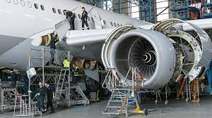
SUB – NATIONAL LEVELS/COLLABORATION
Maintenance, Repair & Overhaul (MRO) Centres
State Governments as well as Private business owners can have their State/private owned MRO .
Ibom Air and Caverton have MROs already
Oyo and Kaduna State Governments already indicated interest to establish one.
Owners of Private Hangers are also encouraged to participate.

Slide 16
Development of Airport Cities (Aerotropolis)
The development of Nigeria’s major commercial airports and surrounding communities into efficient, profitable and self-sustaining commercial hubs through increased private sector participation and Foreign Direct Investment (FDI) will create jobs and grow local industry.
The project will be structured as a Public Private Partnership (PPP) arrangement where the private partner will be required to design, develop, finance and maintain the Aerotropolis during the agreed period.
The Aerotropolis will contain the full complement of commercial facilities that support airlines and aviation linked businesses. Other components of the project include the development of hospitality and tourism oriented real estate assets; and ancillary support infrastructure.
STATUS: Final stage of the Project Development Phase. Outline Business Case completed and submitted to the ICRC for review and issuance of compliance certificate.
NEXT STEP: Commencement of Procurement Phase

Slide 17
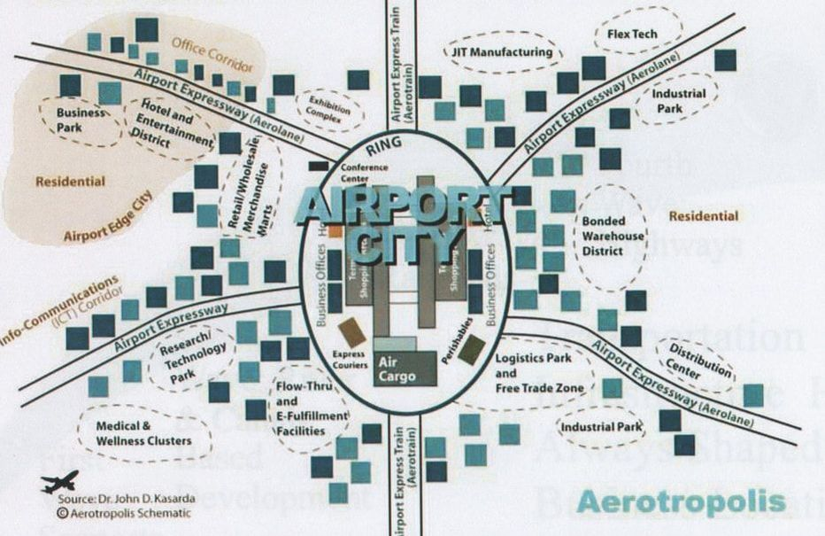
SUB – NATIONAL LEVELS/COLLABORATION
Aerotropolis
Lagos and Abuja Airports are the present locations for this project.
Presently operational in Egypt, South Africa, Dubai, Amsterdam etc

Slide 18
Development of Cargo/Agro-Allied Airport Terminals
To take advantage of the high value agricultural products potential of Nigeria, the need arose to develop dedicated Cargo/Agro-Allied Terminals and ancillary infrastructure in each of the six (6) geographical zones of the country to facilitate the movement of fresh produce by air.
The terminals will be established via a Design, Build, Finance, Operate and Maintain model of Public Private Partnership (PPP).
The proposed terminals will have facilities such as a dry Cargo Terminal Warehouse; Perishable Cargo Terminal with Cool Chain Storage; climate chambers for storage and handling of temperature sensitive products including Pharmaceuticals and Bonded Warehouses.
Status: Final stage of the Project Development Phase. Outline Business Case completed and submitted to the ICRC for review and issuance of compliance certificate.
NEXT STEP: Commencement of Procurement Phase

Slide 19
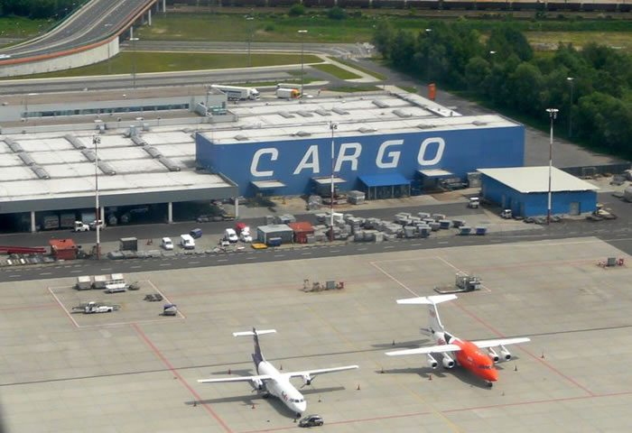
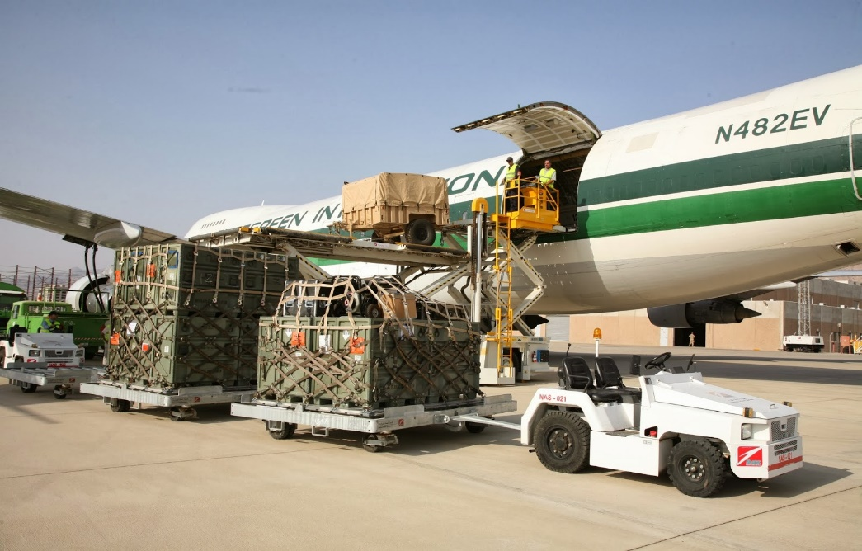
SUB – NATIONAL LEVELS/COLLABORATION
Agro-Allied Cargo Terminals
Kebbi, Katsina, Plateau, Yola, Edo, Ekiti and Calabar are presently being processed as locations for this project.
SUB – NATIONAL LEVELS/COLLABORATION
SUB – NATIONAL LEVELS/COLLABORATION
Kwara State - Ilorin and Imo State - Owerri have shown interest in this project.
Other States are encouraged to develop Cargo /Agro-Allied terminals.

Slide 20
SUB – NATIONAL LEVELS/COLLABORATION
Designation of Airports as Free Trade/Economic Processing Zones.
All Airports are to be designated as Free Trade/Economic Processing Zones in order to encourage businesses/Investments.
Process already on-going for the four (4) major International Airports
Investors in Aviation to have Pioneer Industry Status so as to have tax breaks
TRADE
2021

